Slide 1
CAPSTONE PROJECT DATA SCIENce

Slide 2
Business Problem
Find the Best location in Puerto Rico to start Burger point
Methodology
Understand the neighborhood in order to find the best location for starting new Burger point
Find a location where there are more schools, universities and offices.
Utilized Foursquare API call to do the neighborhood analysis.
Aanalyze the data to find the location where more offices , schools and universities.

Slide 3
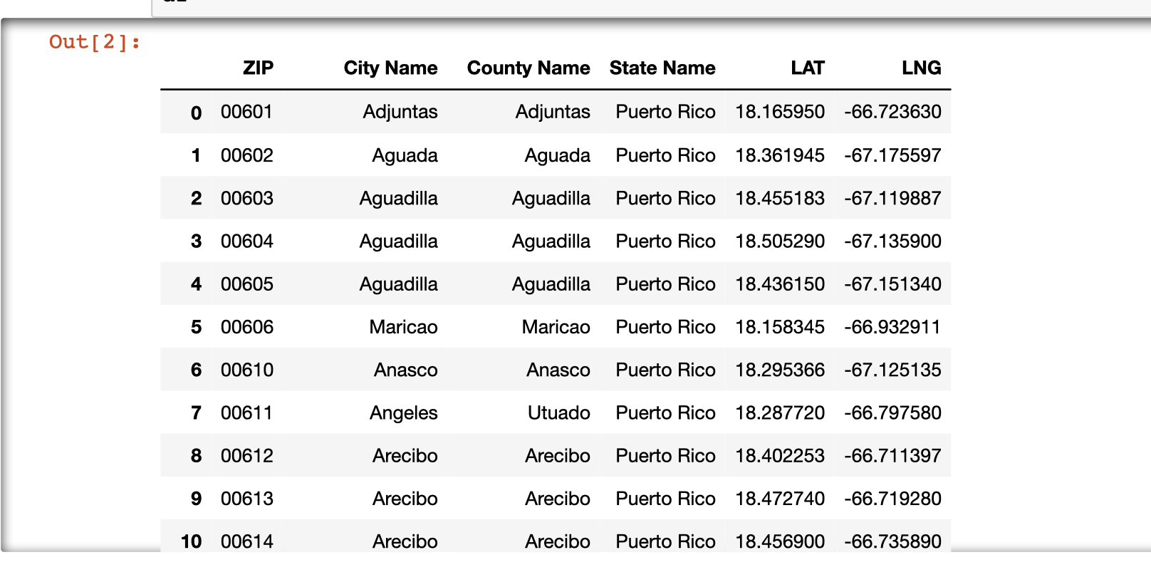
Data Section:
Data for the analysis is taken from the below URL
https://zipcodedownload.com/lookup/Puerto_Rico
It has Zip code, City Name, State Name columns and links to find the latitude and longitude for each Zip code. I have pulled all these details and saved it in csv file

Slide 4
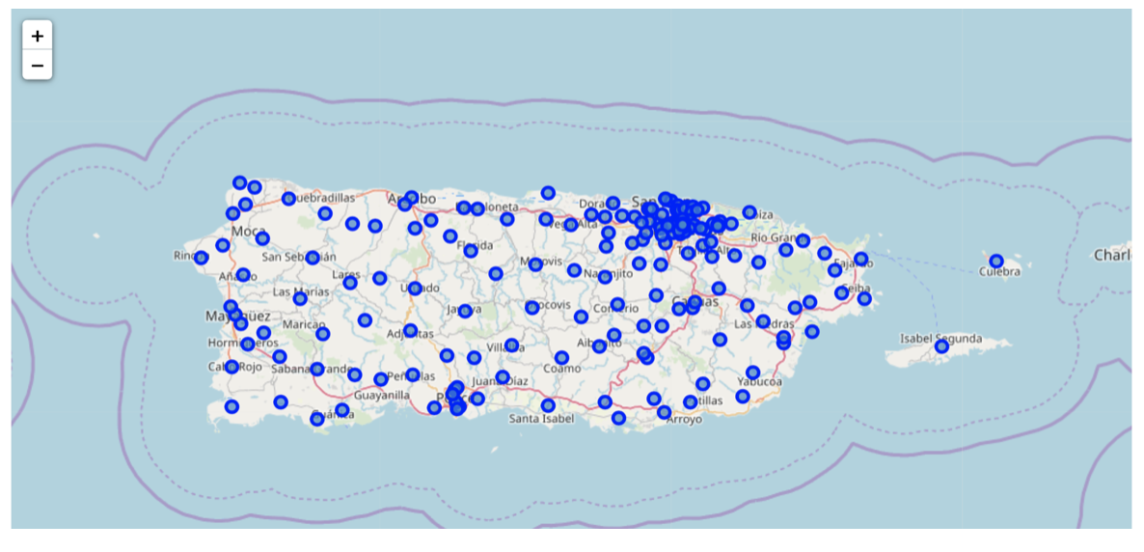
Locations in Puerto Rico
Below map shows the location zip code in Puerto Rico

Slide 5
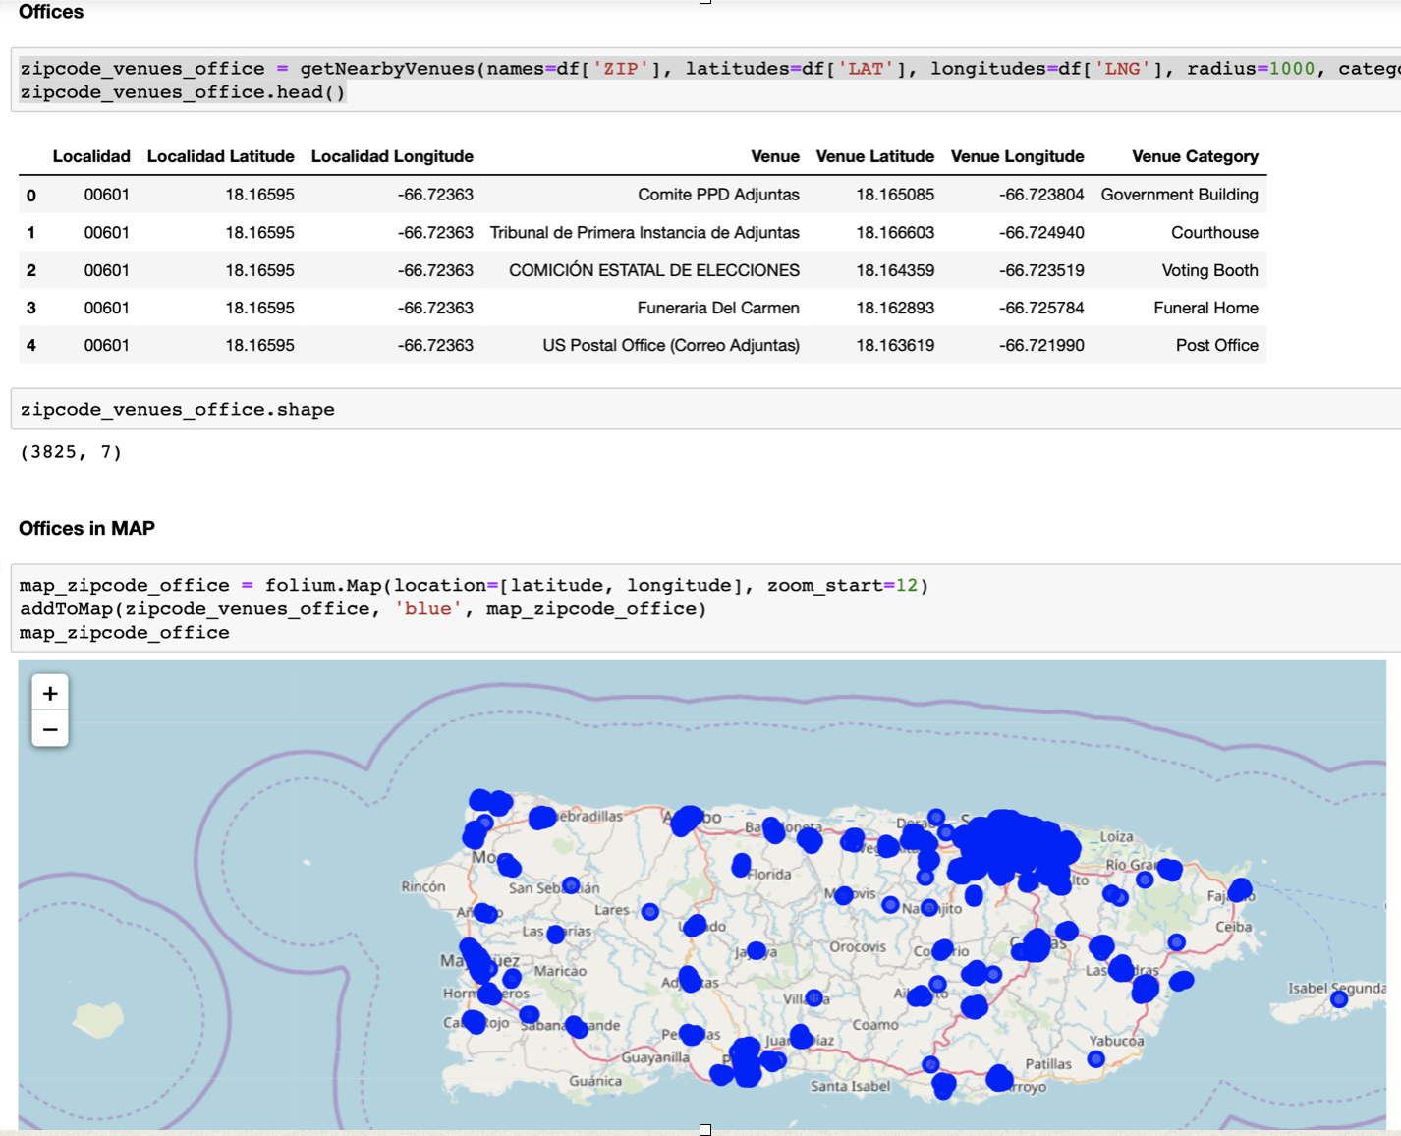
Below table and Map shows the Offices in PR

Slide 6
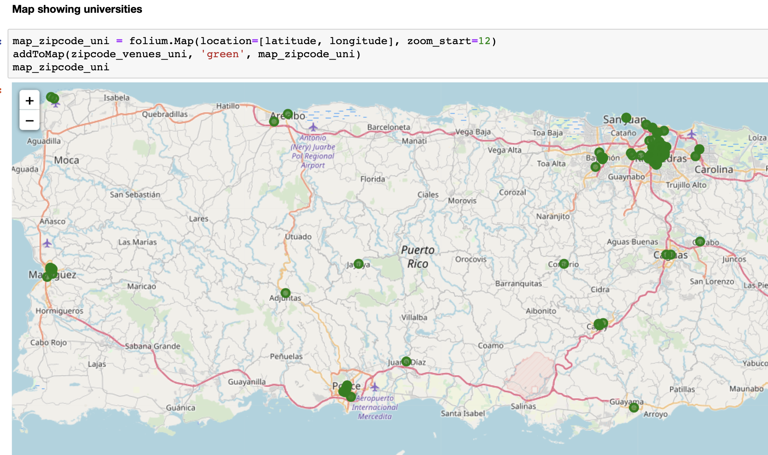
Below map shows the Universities in Puerto Rico

Slide 7
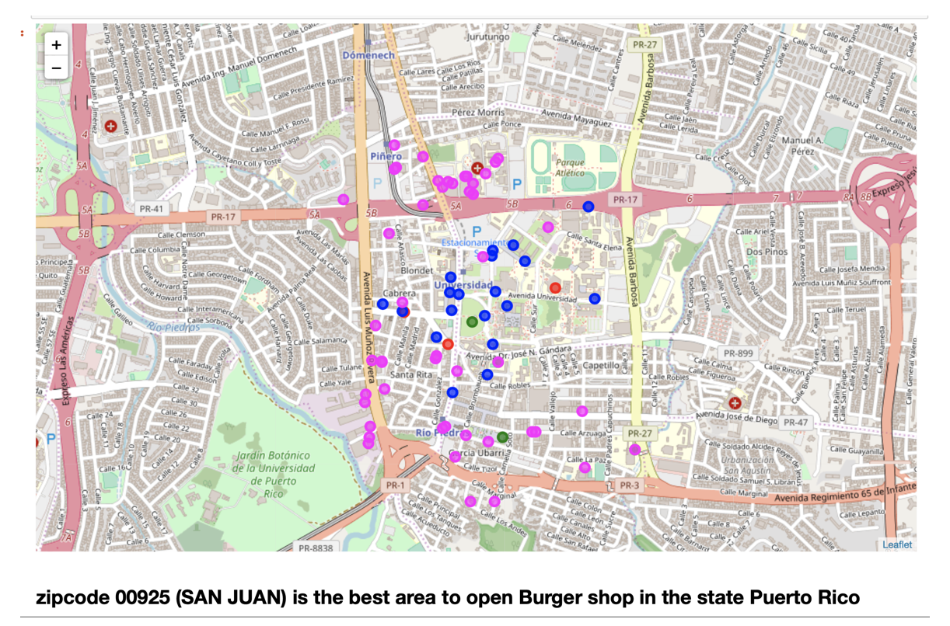
Neighborhood:
Below map shows the neighborhood of our potential place of our new Burger point
Blue shows Universities
Pink shows Offices
Green shows schools
Red shows Burger Points

Slide 8
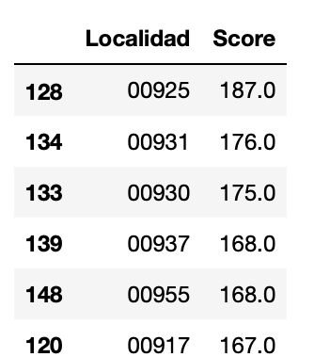
Results and Discussion
The best score goes to the location zip code: 00925.
This location is best for starting a new Burger point.
Conclusion:
One can start a new Burger point at SAN JUAN city in Puerto Rico (zip code 00925)
to serve more people and earn more profits

